Slide 1


Get Data
Notes:
Hi everyone,
My name is Shiraj Ahmad,
and I'm a mentor here for data science.
In this session I will be explaining how we can get the data and connect it with Power BI and Excel

Slide 2
Content
GitHub Account Creation
Data Connection
Power BI
With CSV File
With SQL
Excel
With CSV
Access Capstone Project Repository
SQL
With CSV
With SQL
Notes:
I will be covering below topiccs

Slide 3

GitHub Account Creation

Slide 4
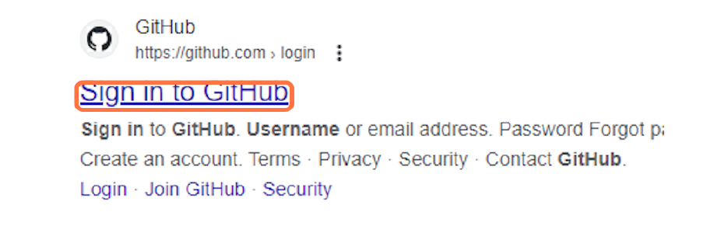
Step 1
Go to https://github.com/login

Slide 5
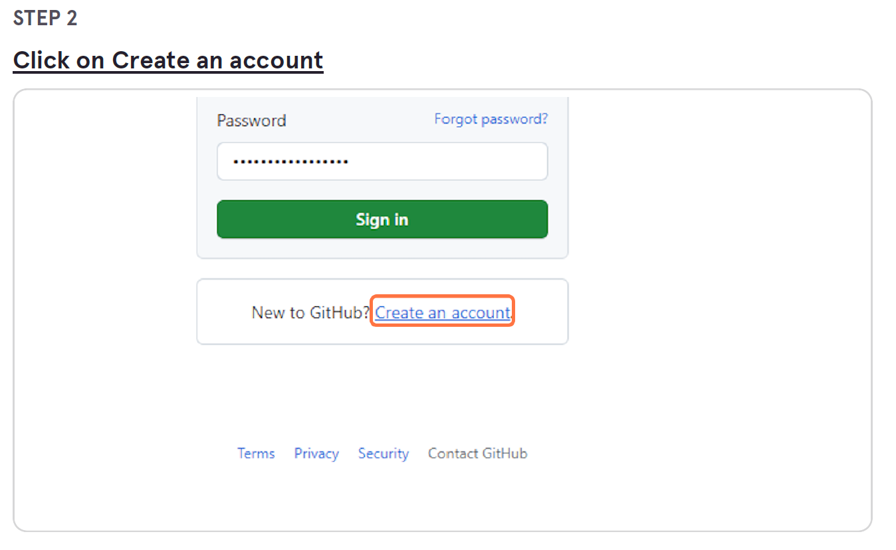

Slide 6
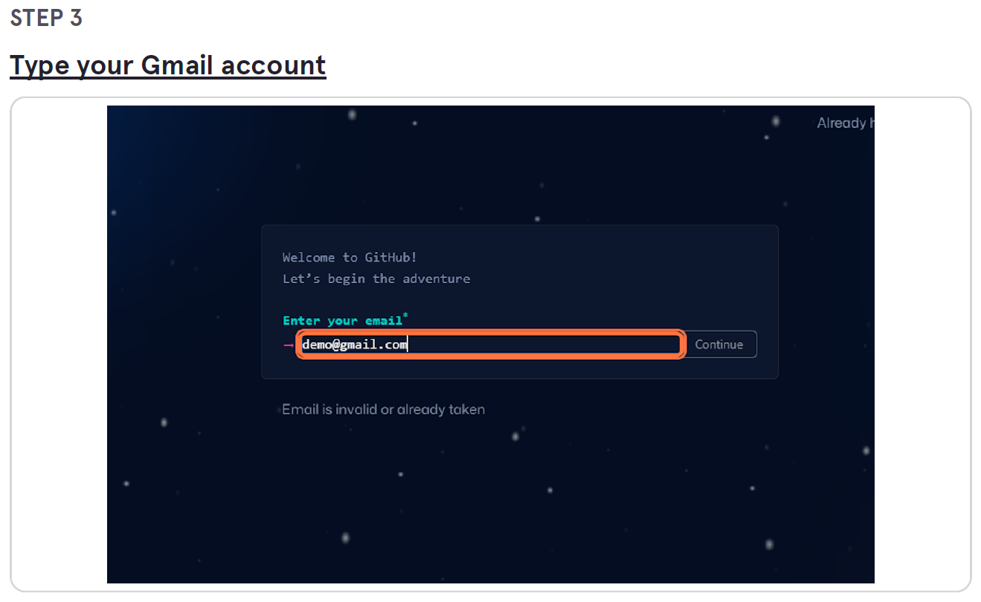

Slide 7
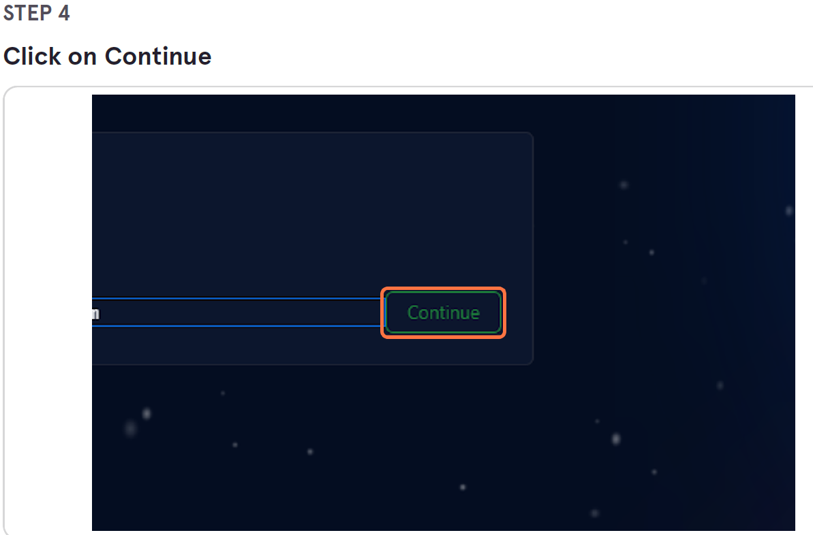

Slide 8
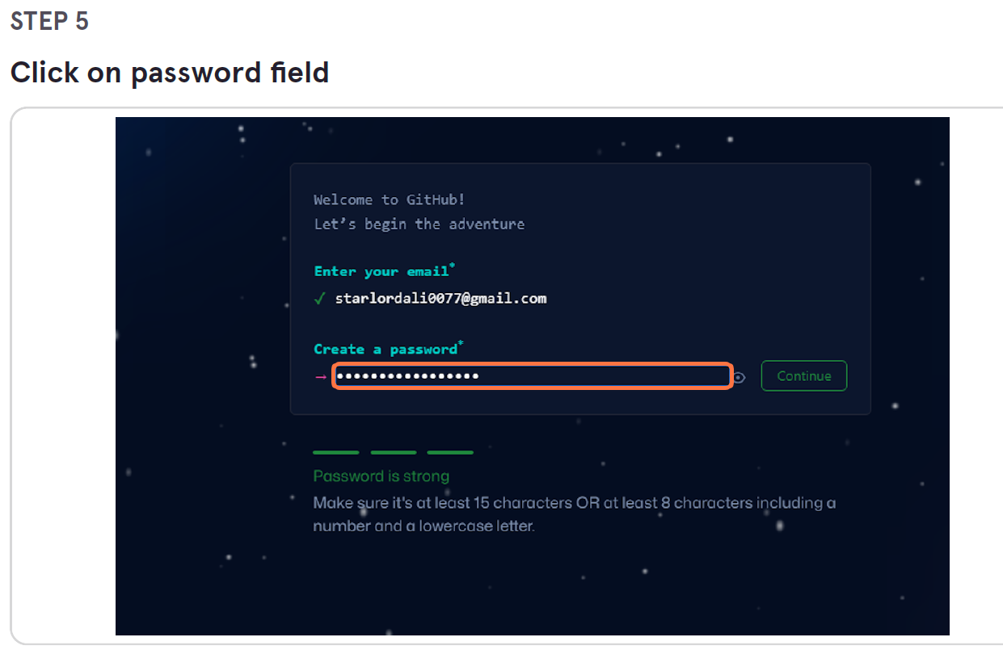

Slide 9
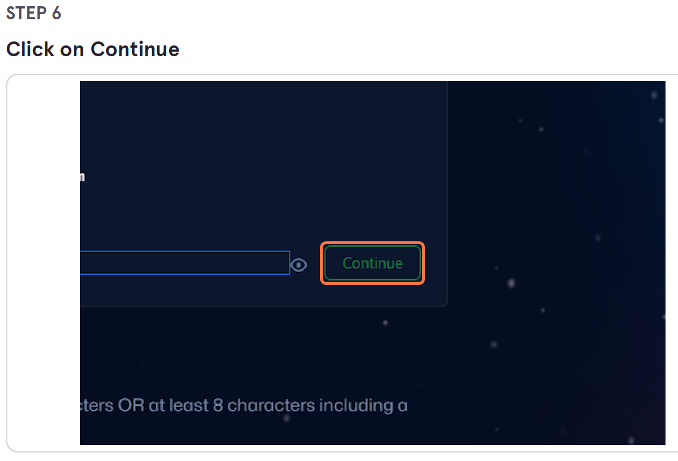

Slide 10
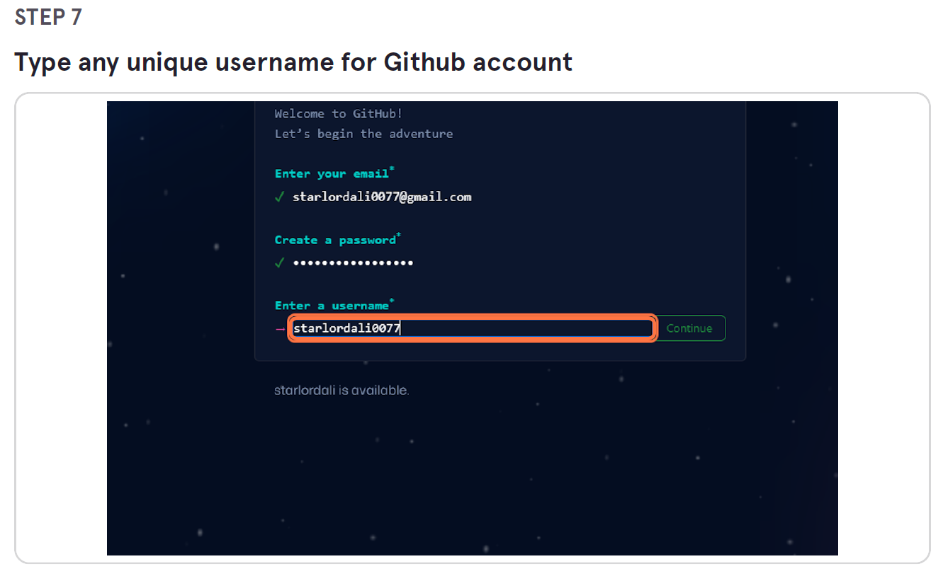

Slide 11
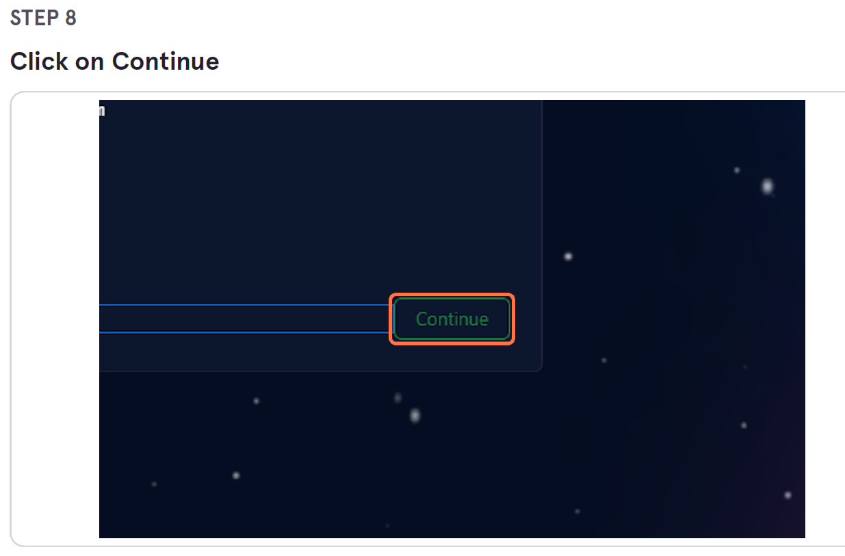

Slide 12
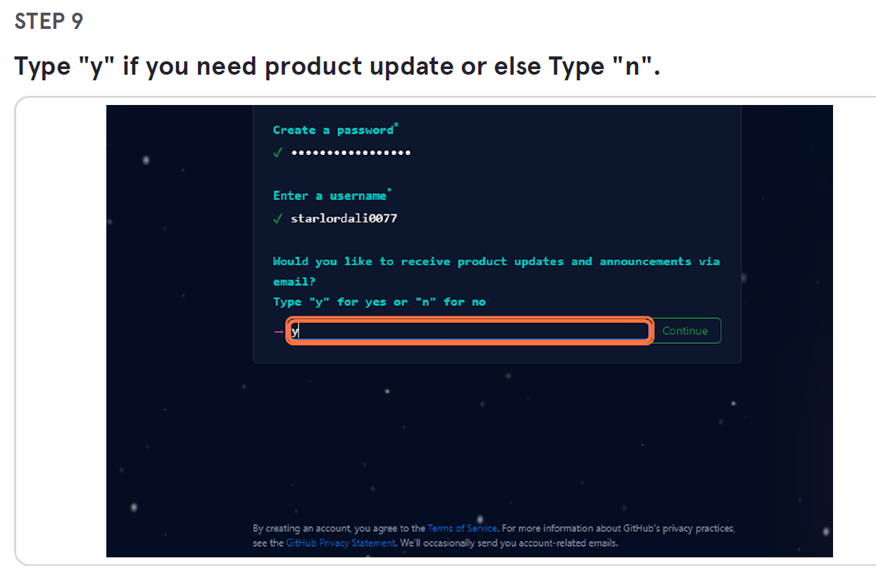

Slide 13
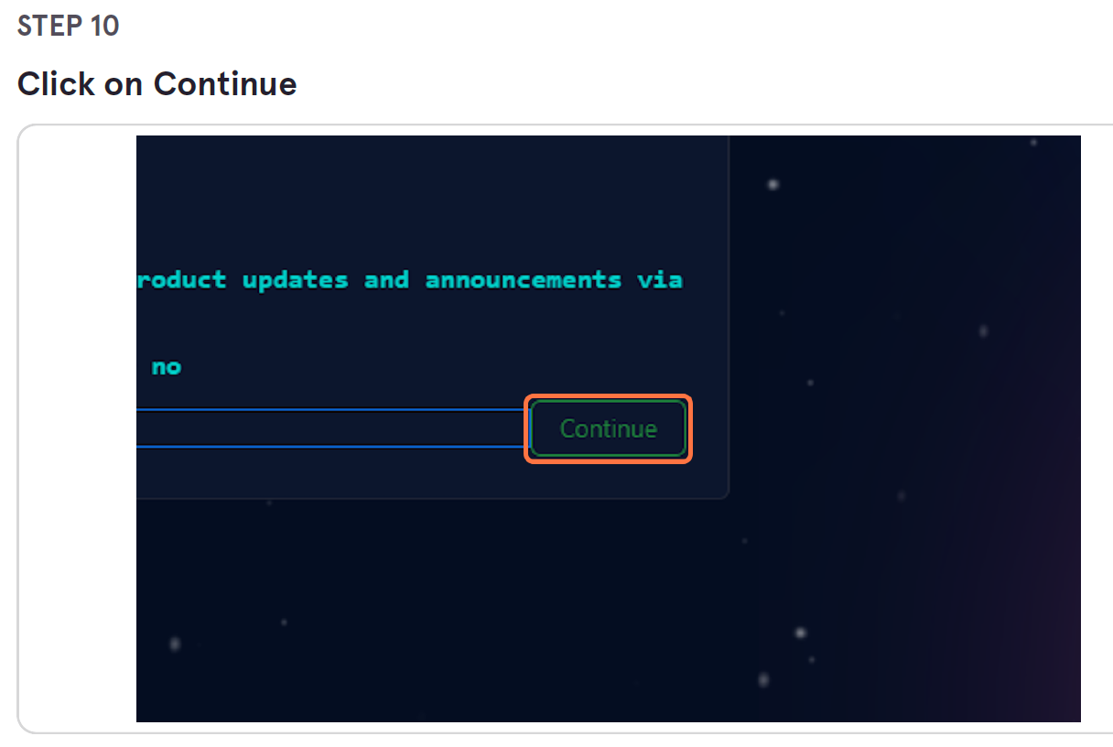

Slide 14
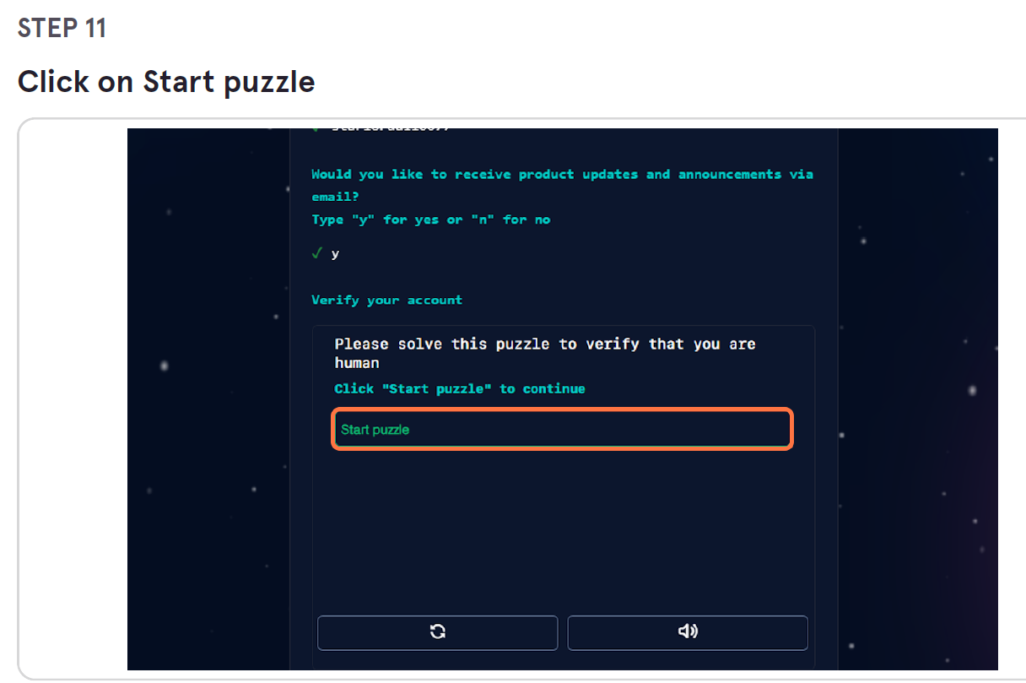

Slide 15
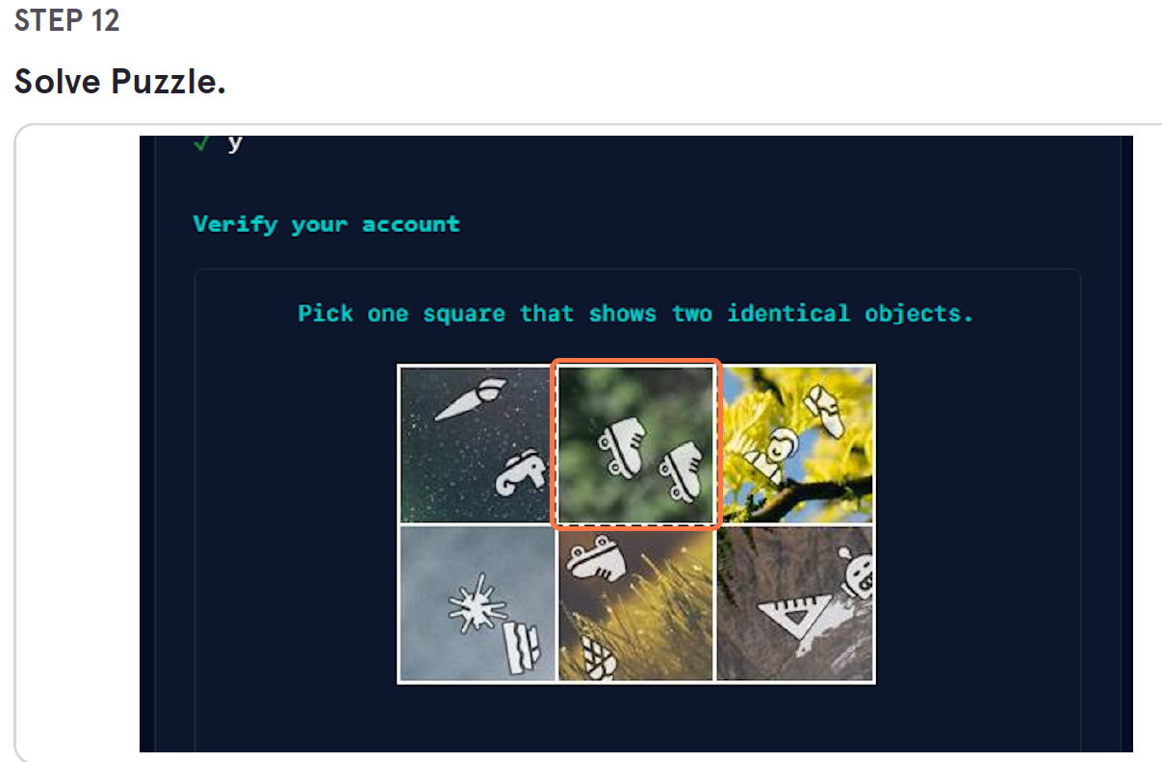

Slide 16
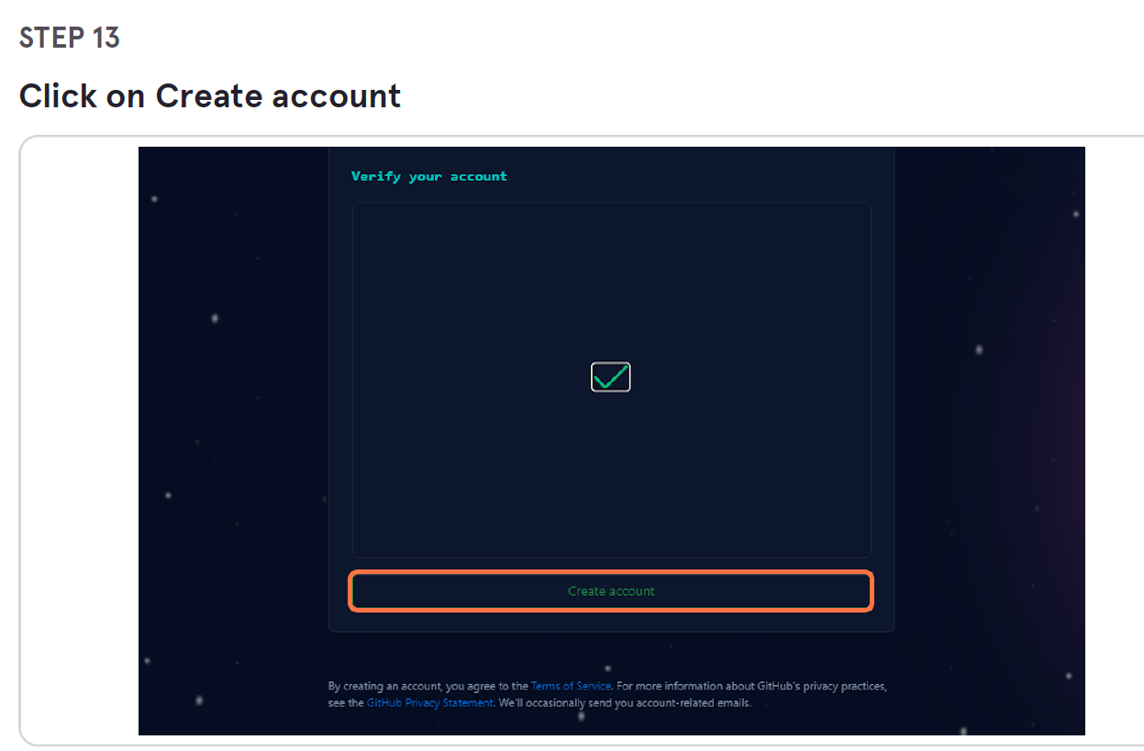

Slide 17
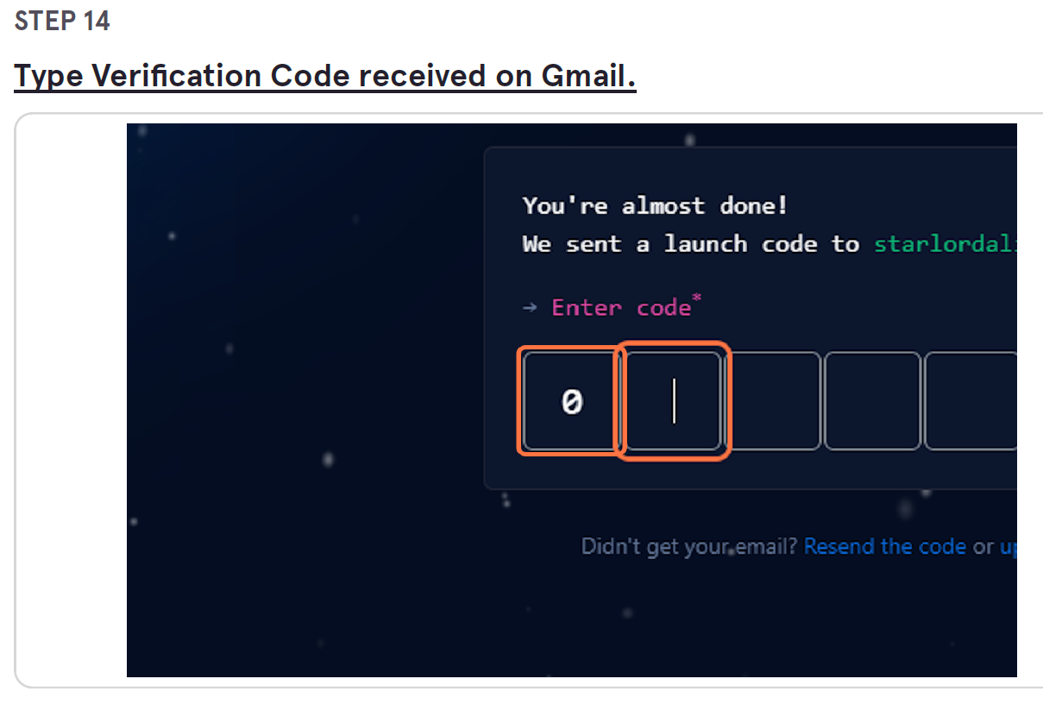

Slide 18
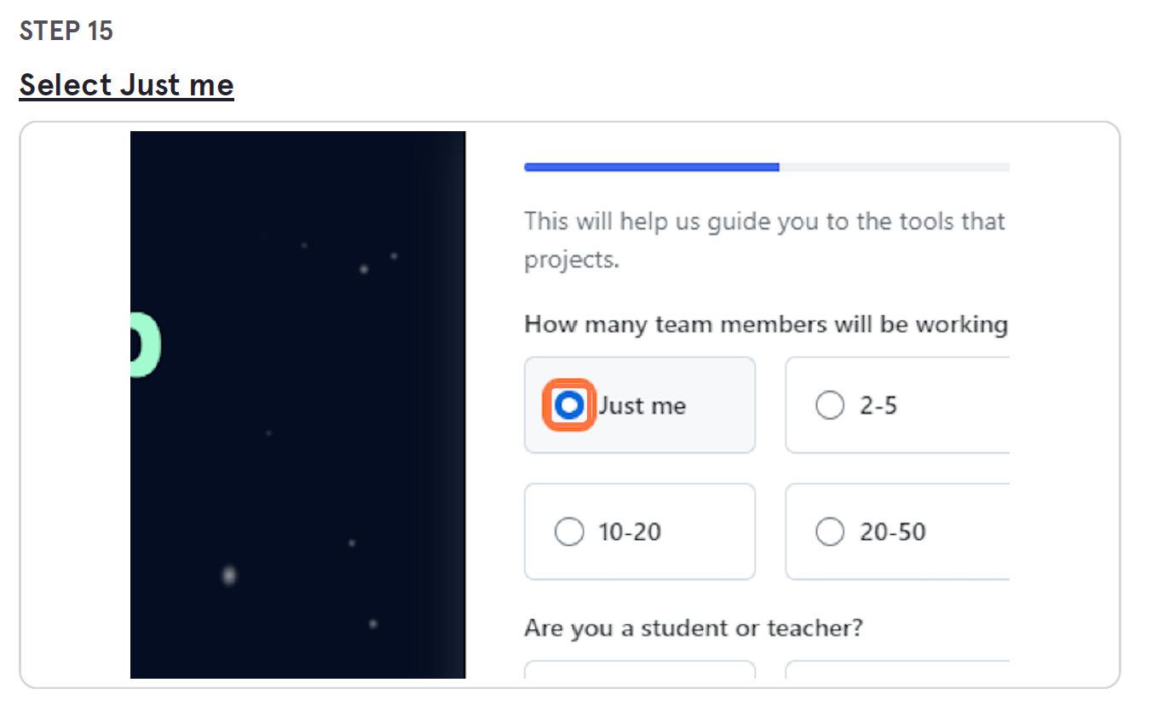

Slide 19
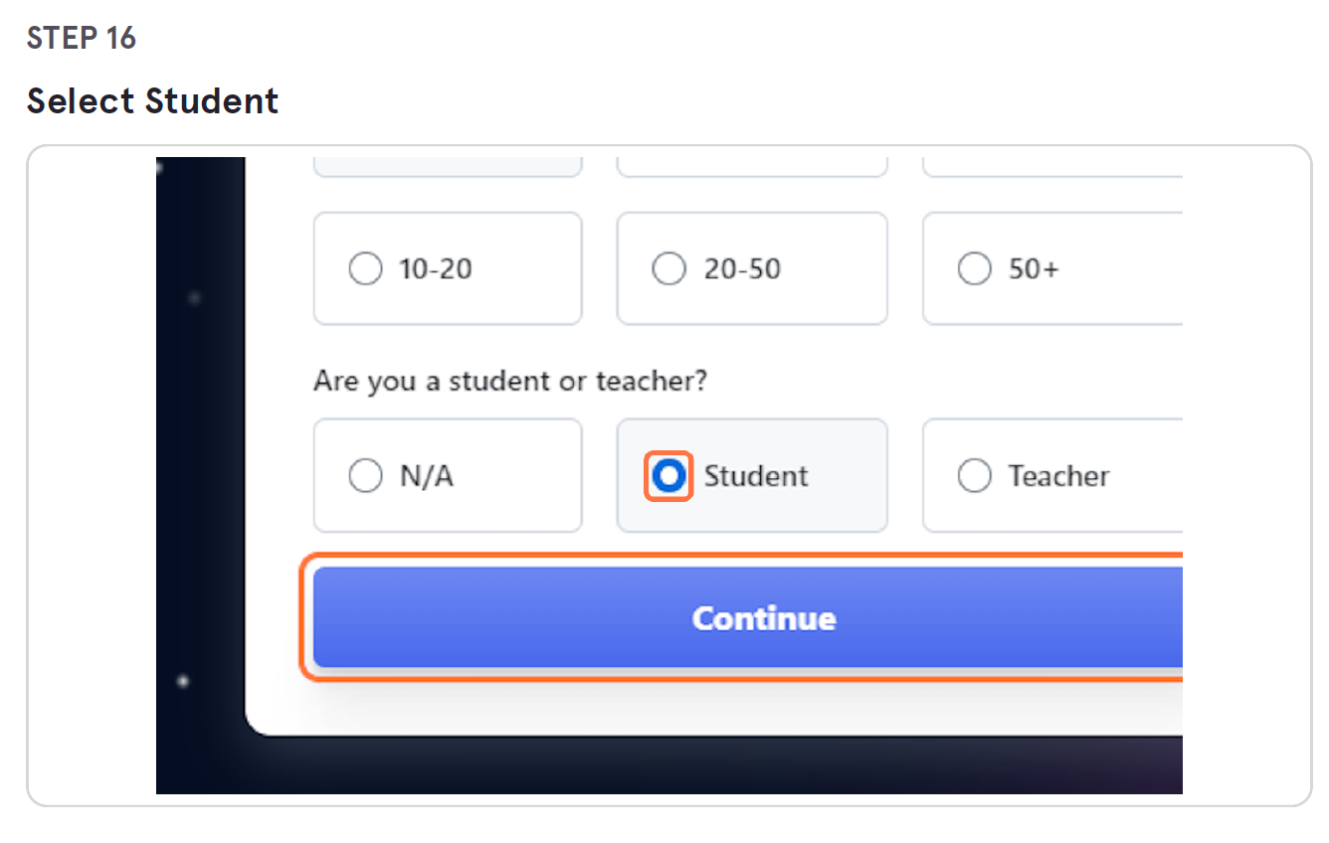

Slide 20
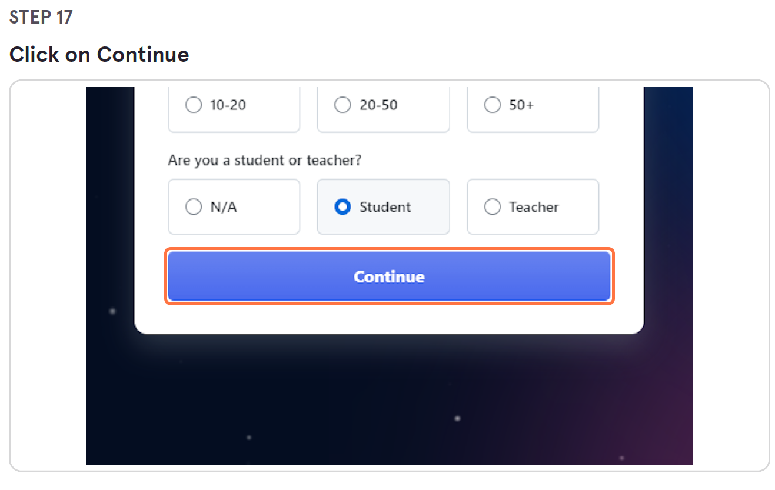

Slide 21
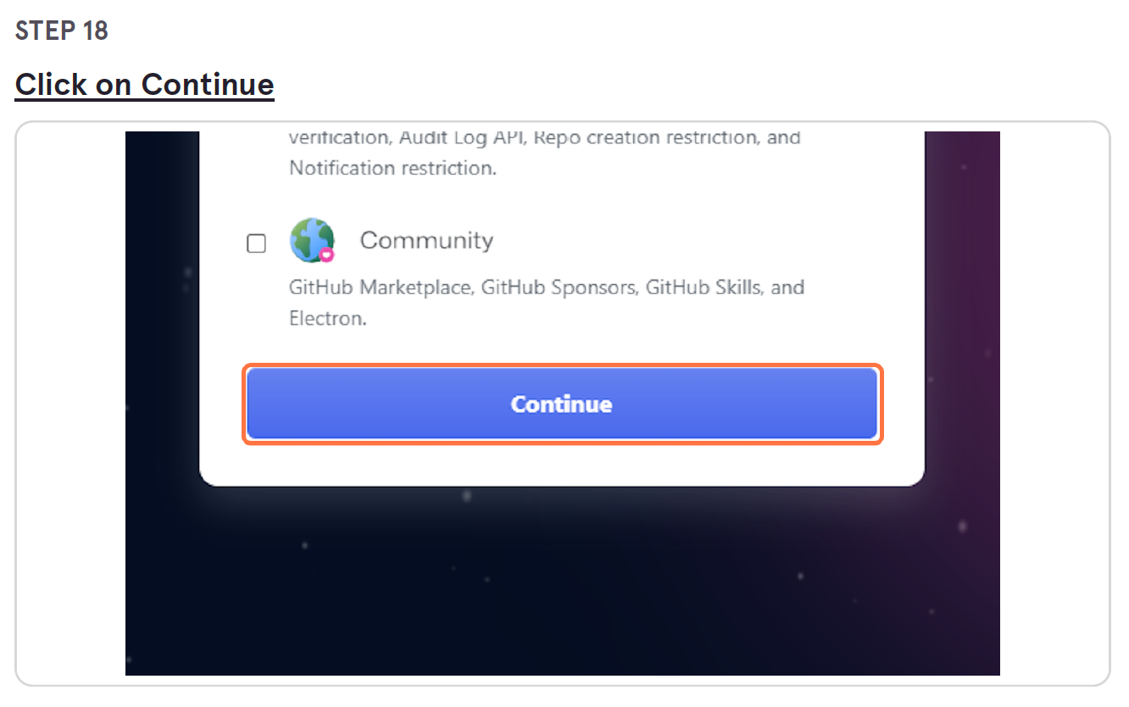

Slide 22
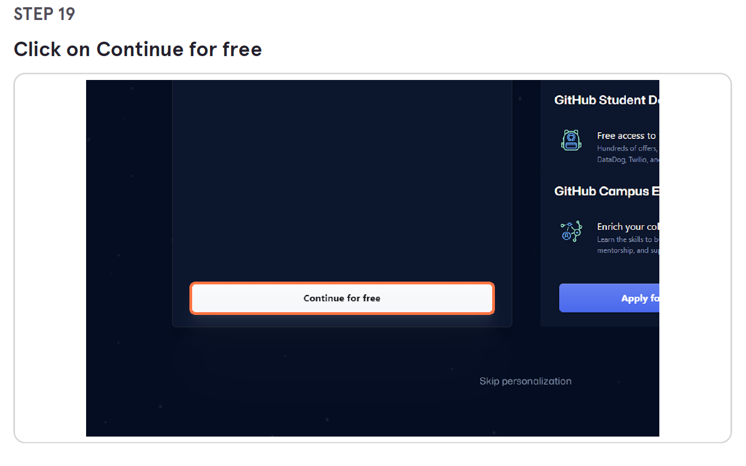

Slide 23
Access Capstone Project GIT Repository

Slide 24
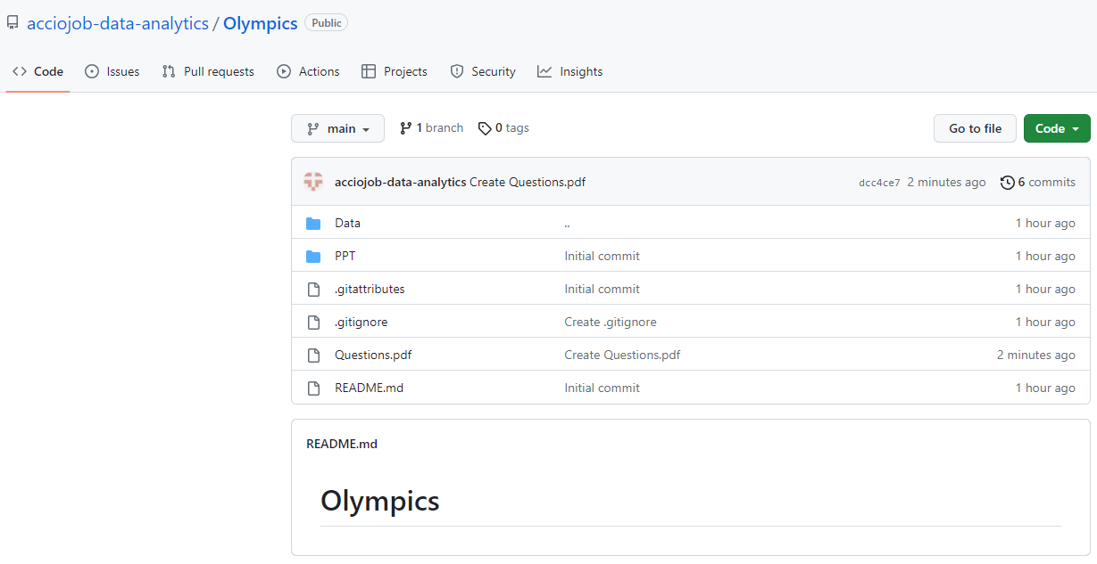
Click on Git Repository Link received for project.

Slide 25
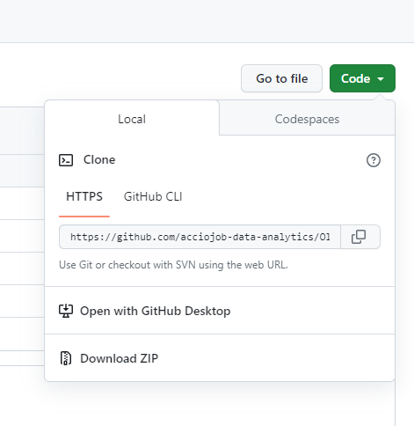
Click on Code. Then Click on Download Zip

Slide 26
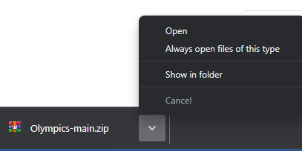
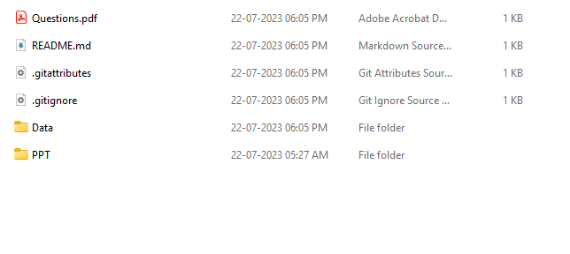
It will download zip folder. Extract Zip
Files after Zip extraction.

Slide 27



Data Connection – Power BI

Slide 28
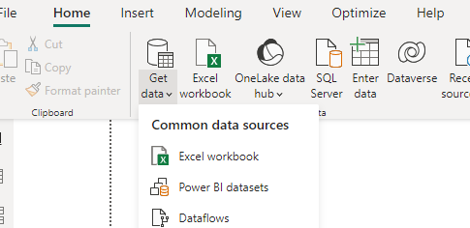
Power BI - CSV
Open Power BI Desktop
Click on Get Data Under Home Menu

Slide 29
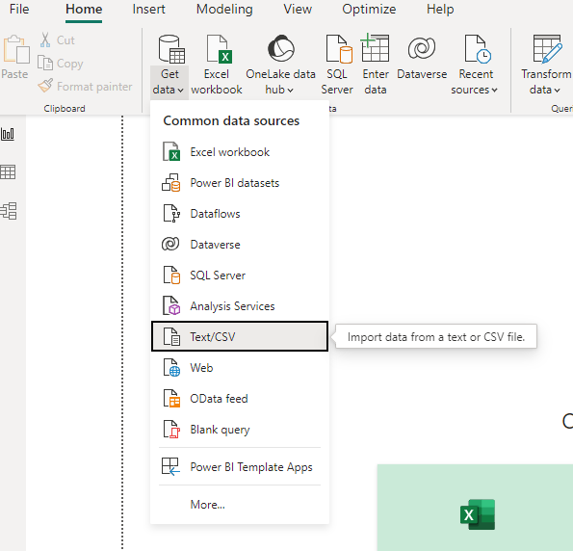
Click on Text/ CSV

Slide 30
Click on Text/ CSV File Explorer window will open to select csv file Navigate to Extracted Zip Folder

Slide 31
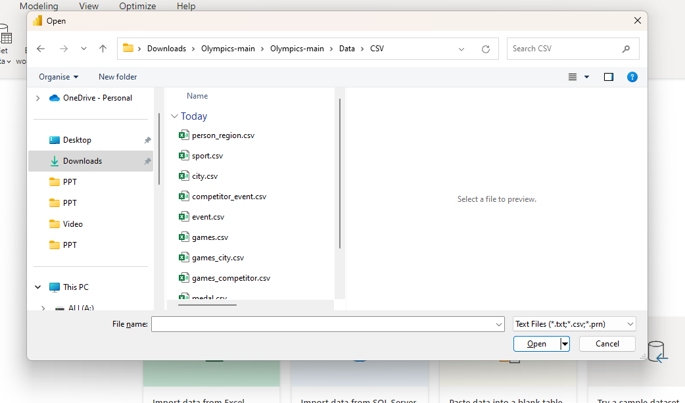
Select csv file to import Click on open

Slide 32
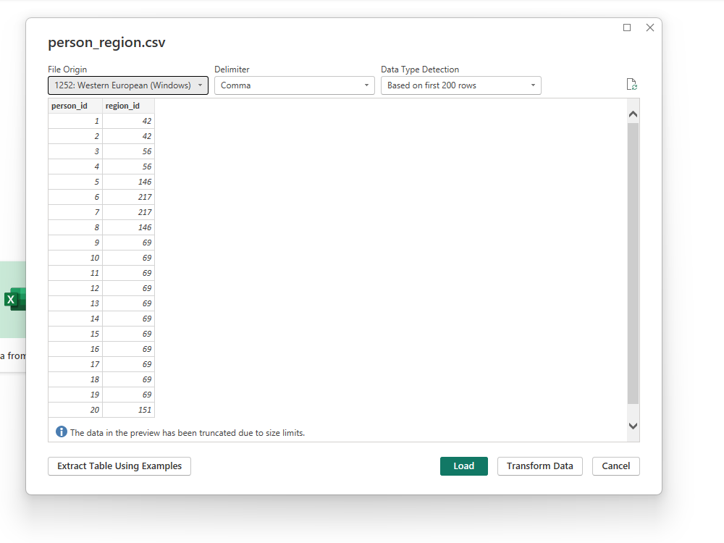
Click on load to load the file OR Transform Data to transform then file

Slide 33
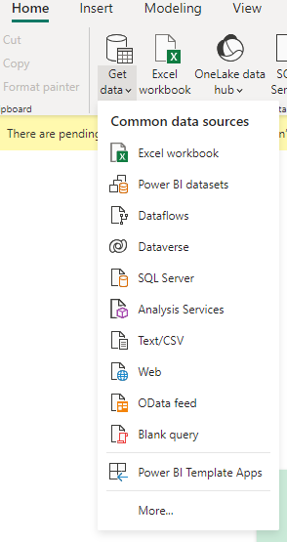
Power BI - SQL
Open Power BI Desktop
Click on Get Data Under Home Menu
Click on “More” Option

Slide 34
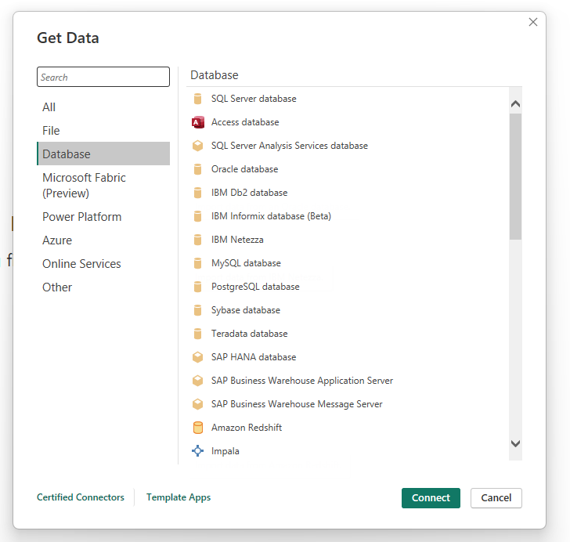
Select Database Then Select MySQL

Slide 35
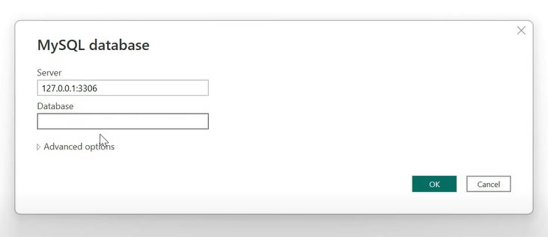
Under Server name – 127.0.0.1:3306 or provided server name Database When asked for credentials enter Username – default root Password – at the time of installation

Slide 36
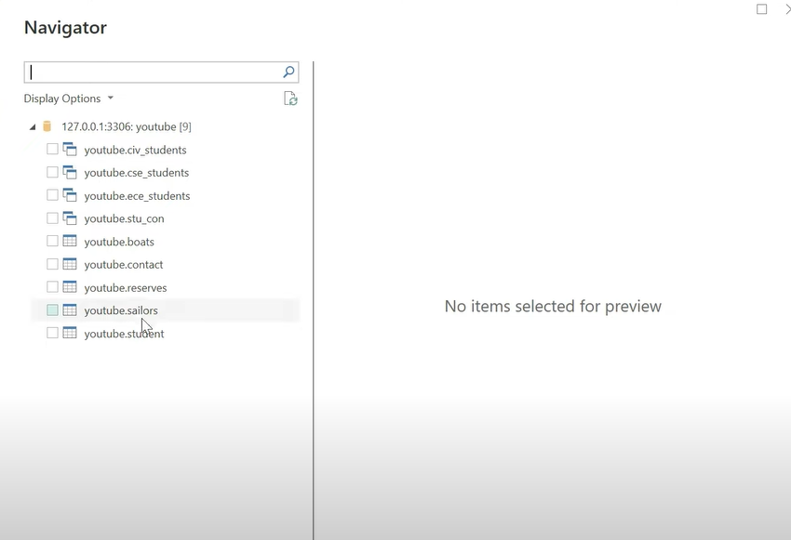
It will give you the list of all the tables of the database

Slide 37
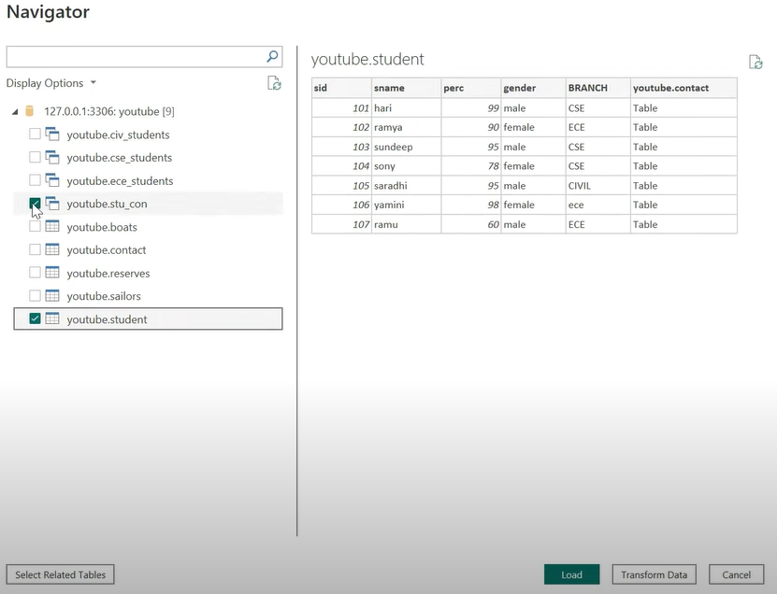
Selects required tables then you can choose if you want to directly load it or transform it

Slide 38
Excel - CSV

Slide 39
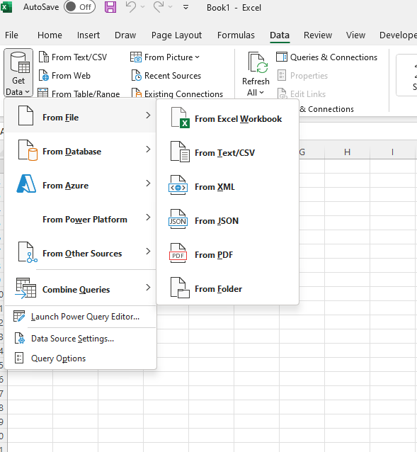
Open Excel Go to Data Tab Click on Get Data Click on From File Click on From Text/CSV

Slide 40
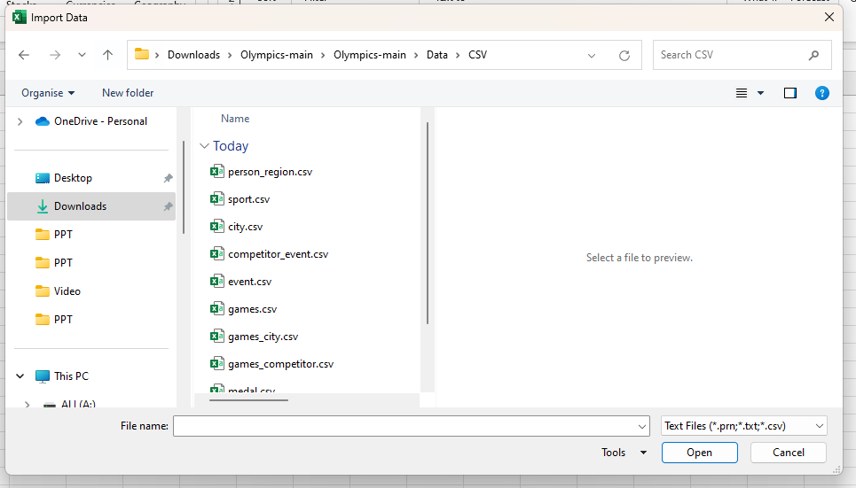
Navigate to extracted folder and select csv file you want to add

Slide 41
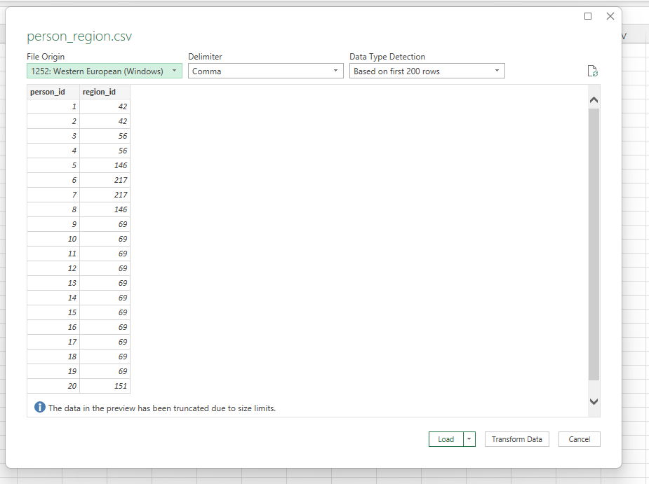
You will get option to directly load it or transform it chose option accordingly

Slide 42
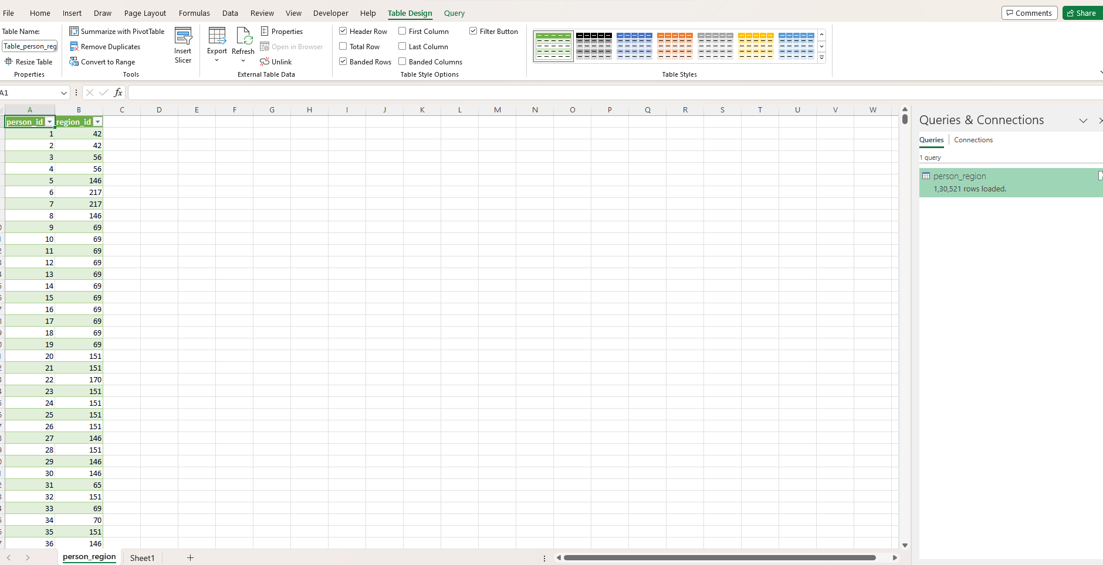
After successfully loading the table, it will create new sheet with that table

Slide 43
SQL - CSV

Slide 44
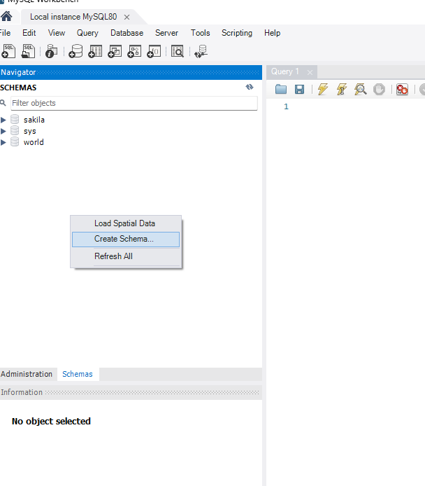
Open Mysql Workbench Login to local instance Right Click under Navigator Click on Create Schema to create new schema/ Database Create schema as per your project name

Slide 45
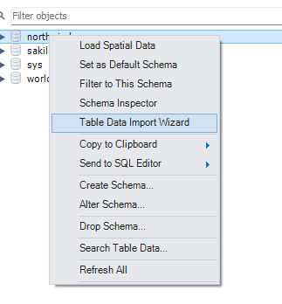
Right click on Database Select Table Data Import Wizard

Slide 46
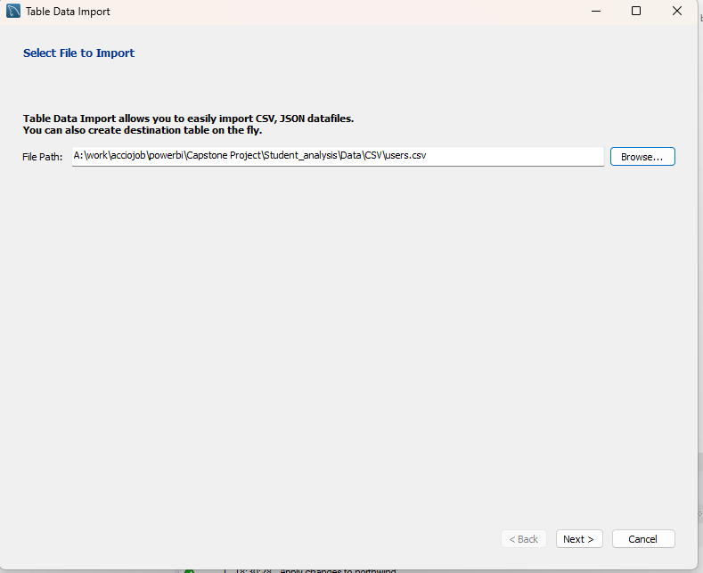
Navigate to Extracted data folder Under CSV Select required File Click on Next – 5 times

Slide 47
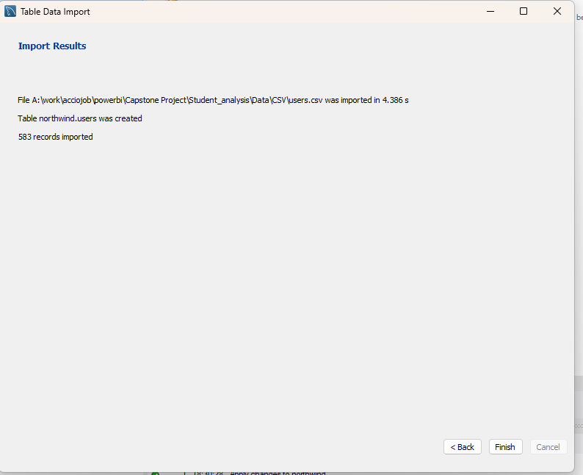
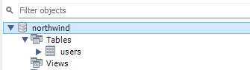
Once all the data is exported you will get below screen click on finish

Slide 48
SQL – SQL Script

Slide 49
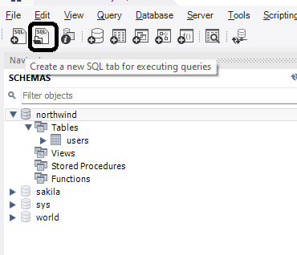
Open Mysql Workbench Login to local instance Right Click under Navigator Click on Create Schema to create new schema/ Database Create schema as per your project name Select schema using below command USE <Database Name>
Click on the Highlighted Icon to open SQL Script

Slide 50
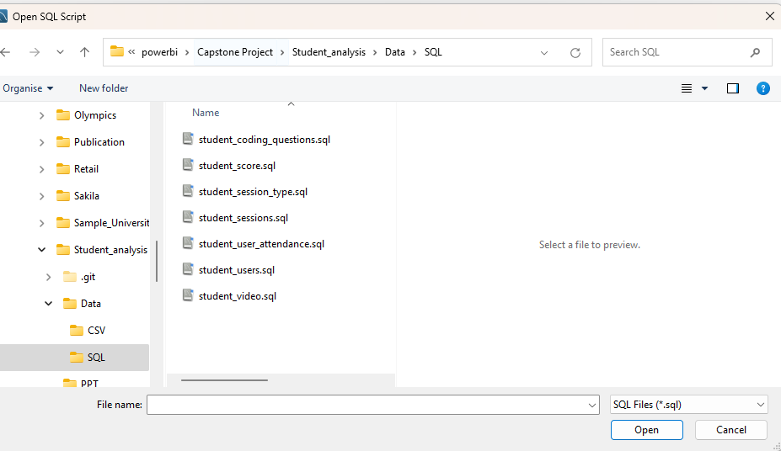
Navigate to Extracted folder Under Data Folder we have SQL subfolder Within that you will find script for each tables Select script click on open

Slide 51
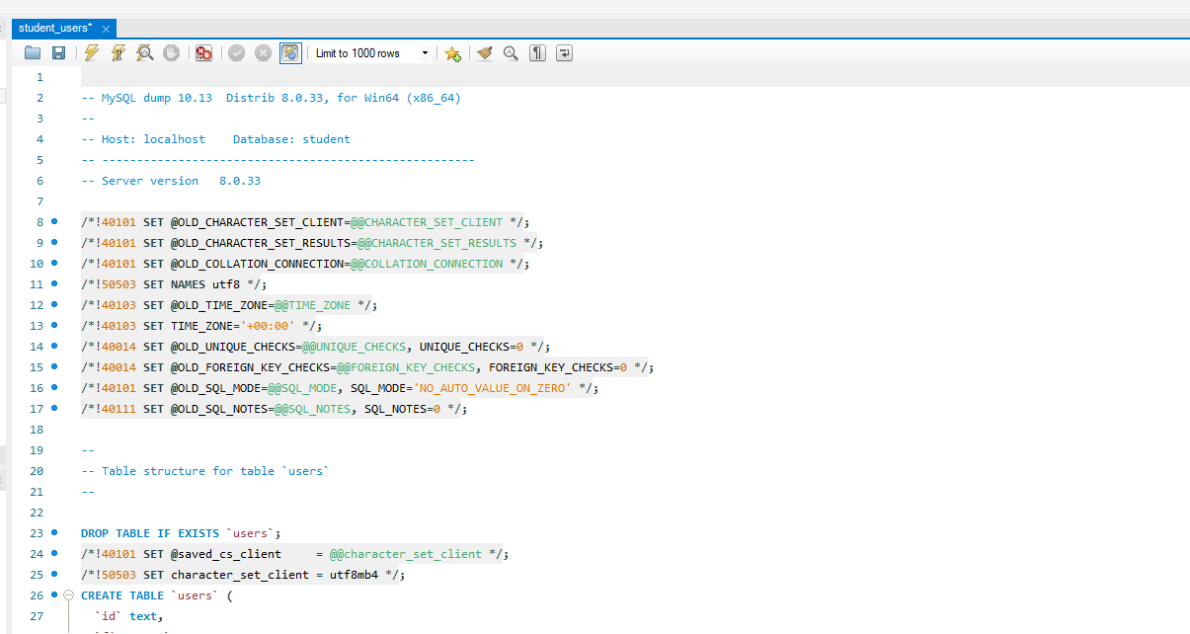
It will open SQL Script. Run the script to get table data.

